Slide 1
Error
Validation Error
Training Error
Epoch
Early Stopping Epoch

Slide 2
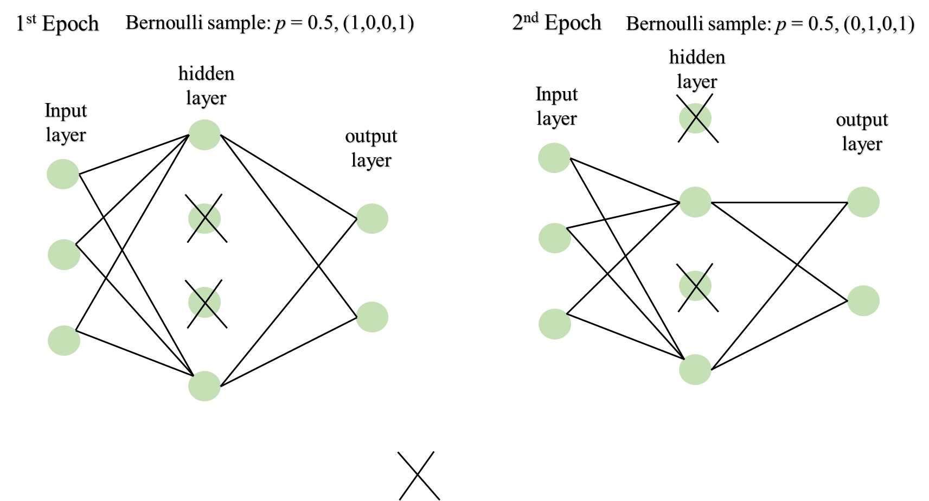
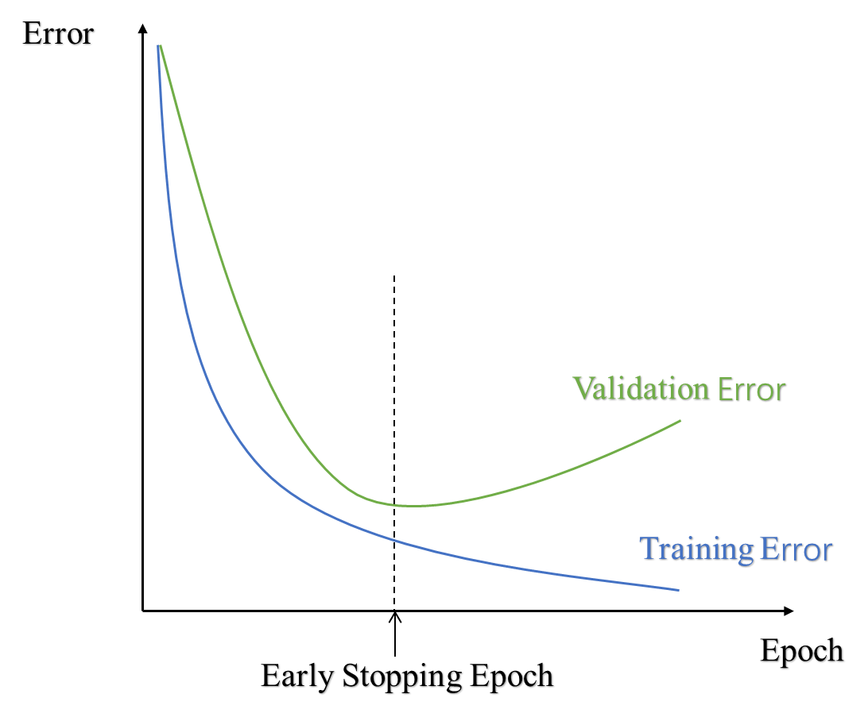
80%
20%
Train set
Validation set

Slide 3
1st Epoch
Bernoulli sample: p = 0.5, (1,0,0,1)
2nd Epoch
Bernoulli sample: p = 0.5, (0,1,0,1)
hidden
layer
hidden
layer
Input
layer
Input
layer
output
layer
output
layer

Slide 4
Regression
FuncNN
Prediction
Smooth
Regression
FLM
Prediction
Raw data
Regression
PCA
Smooth
FLM
Prediction

